Slide 1
Gens, Ordinadors i Malalties

Slide 2
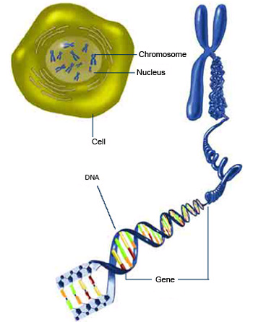
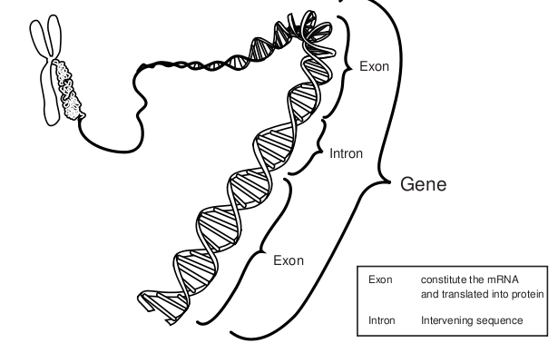
Genes are made of DNA

Slide 3
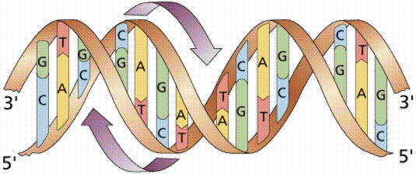
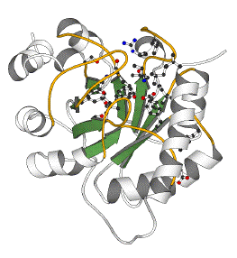
The central dogma
DNA
CCTGAGCCAACTATTGATGAA
transcription
mRNA
CCUGAGCCAACUAUUGAUGAA
translation
Protein
PEPTIDE

Slide 4
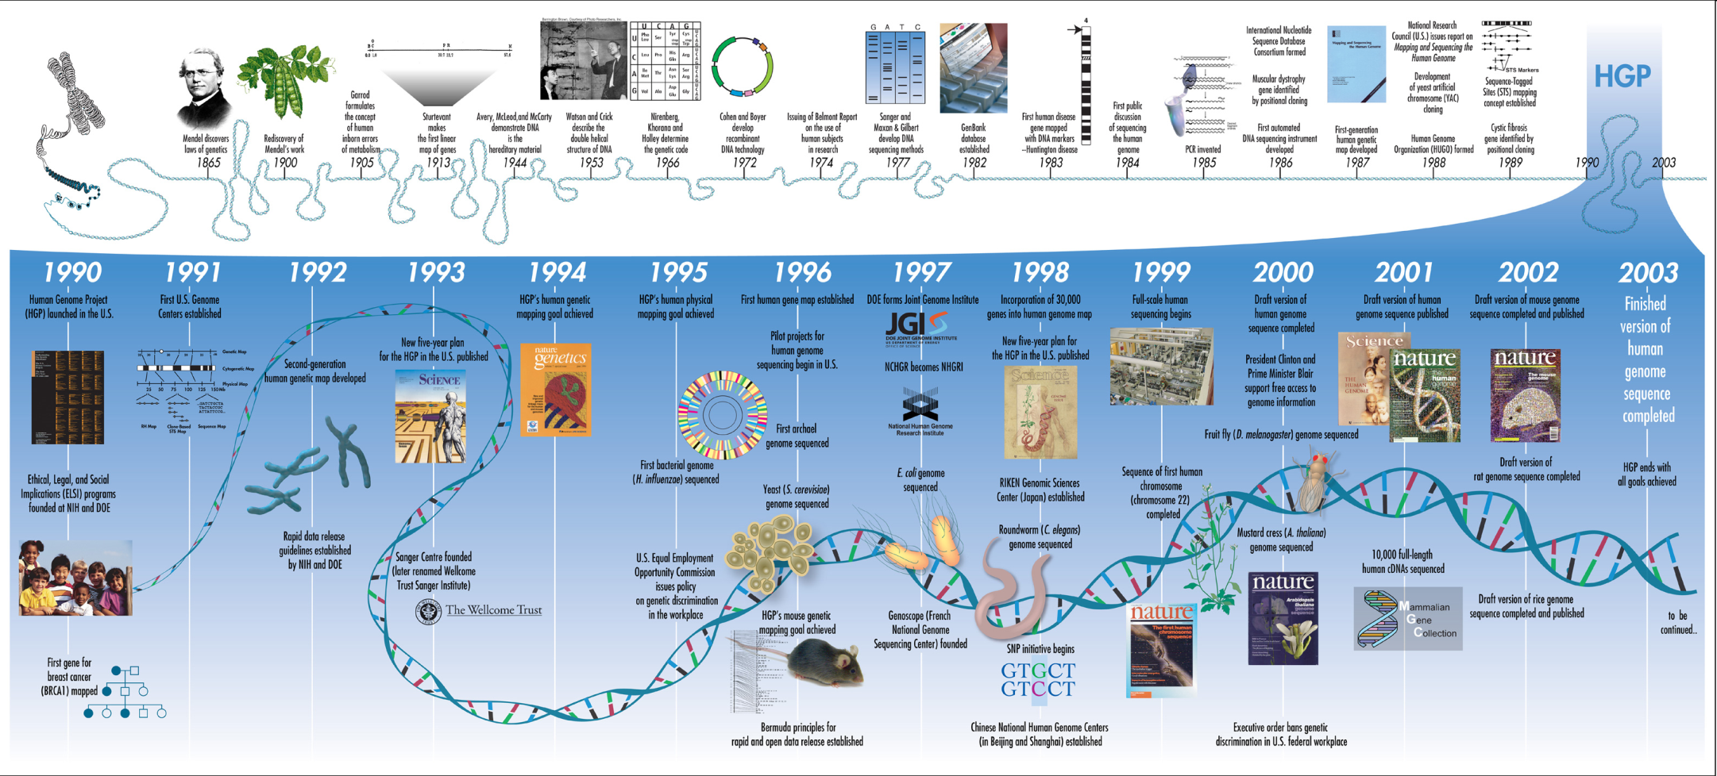
The human genome project

Slide 5
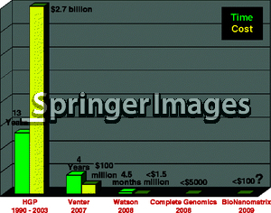
Decreasing costs & Increasing capabilities of genome sequencing
Project | Human Genome project | Venter’s genome | Watson’s genome | Anybody’s
Year | 2003 | 2007 | 2008 | 20012
Time needed | 13 years | 4 years | 4.5 months | 2 weeks
Cost | $27000 million | $ 100 million | < $1.5 million | <$10000
Coverage | 8-10x | 7.5x | 7.4x | 8x
# of scientists | 2800 | 31 | 27 | 1-3
# of Institutes | 16 | 5 | 2 | 1
# of Countries | 6 | 3 | 1 | 1

Slide 6
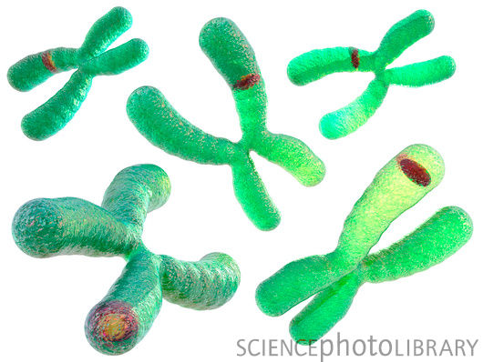
Defining genetic disease
Genetic disorders are caused by abnormalities in the
genetic material
Abnormalities can range from a small mutation in a single gene to the addition or subtraction of an entire chromosome or set of chromosomes.
In general, four types of genetic disorders can be distinguished

Slide 7
Diseases and genetic diseases
traditionally - 3 types of diseases
1. genetically determined
2. environmentally determined
3. 1. + 2.
today - distinctions are blurred
up to 20% of pediatric in-patients have genetic abnormality
about 50% of spontaneous abortuses have chromosomal aberration
only mutations that are not lethal are reservoir of genetic diseases

Slide 8
Terminology
hereditary = derived from parents
familial = transmitted in the gametes through generations
congenital = present at birth (not always genetically determined - e.g. congenital syphilis, toxoplasmosis)
! not all genetical diseases are congenital - e.g. Huntington disease - 3rd to 4th decade of life

Slide 9
Classification
3 groups of genetic diseases
1. Disorders with multifactorial inheritance (polygenic)
2. Monogenic (mendelian) disorders
3. Chromosomal aberrations

Slide 10
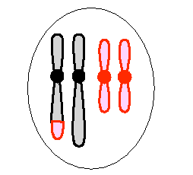
Classification of genetic disorders
Multifactorial
Single gene
Chromosomal
Mitochondrial
Somatic mutations (cancer)
+ environment
Male
Posar exemples

Slide 11
Gene identification/finding of inherited disease
Every gene has a specific task
Identification of disease genes is similar to finding genes responsible for normal functions
The mutation may be within a gene/protein or within a regulatory part of the genome that, e.g., affects the amount of protein being produced.
The mutation changes the protein, which alters the way the task is usually performed
DISEASE

Slide 12
Bioinformatics approach to disease gene identification
The release of genomic sequences, full-lenght cDNA sequences, expressed sequence tags (ESTs), and large-scale expression micro-array data of human and model organisms (e.g. Mus Musculus) offer invaluable resources for studying genetic diseases.
This huge amount of data is stored in numerous different databases, thus making the use of high performance computing an essential tool for decoding the information contained in these databases.

